Slide 1

An Introduction to CUDA/OpenCL and Graphics Processors
Bryan Catanzaro, NVIDIA Research

Slide 2
Heterogeneous Parallel Computing
Latency Optimized CPU
Fast Serial Processing
Throughput Optimized GPU
Scalable Parallel Processing

Slide 3
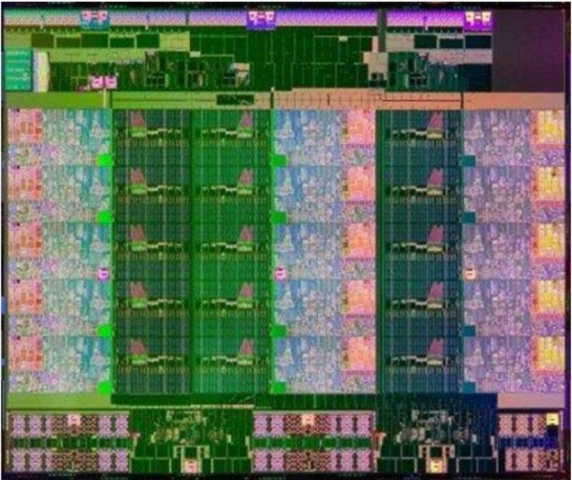
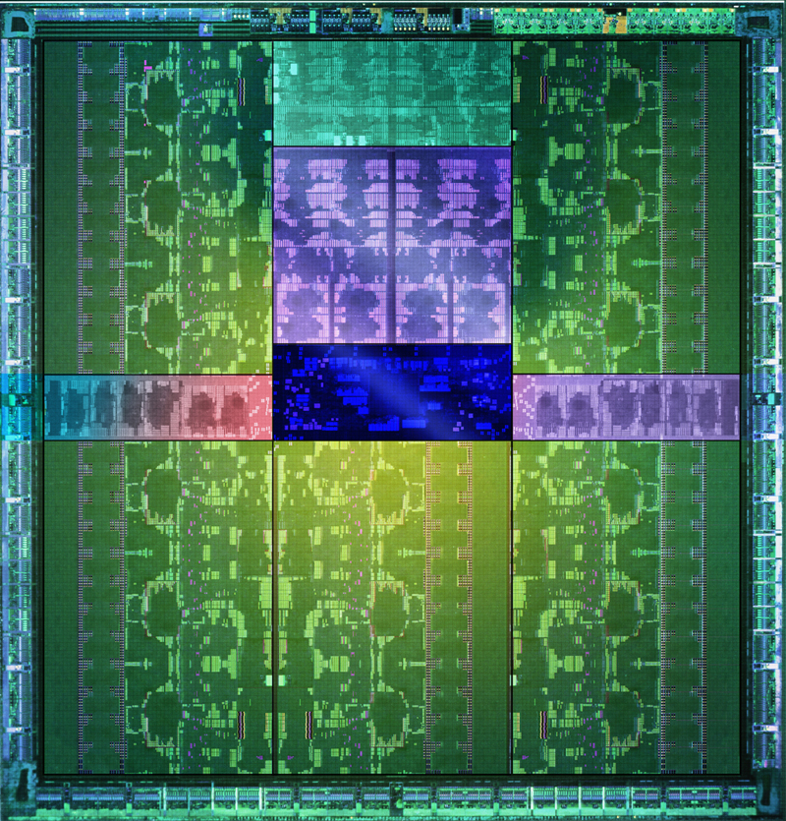
Latency vs. Throughput
Specifications | Ivy Bridge EX (Xeon E7-8890v2) | Kepler (Tesla K40)
Processing Elements | 15 cores, 2 issue, 8 way SIMD @2.8 GHz | 15 SMs, 6 issue, 32 way SIMD @745 MHz
Resident Strands/Threads (max) | 15 cores, 2 threads, 8 way SIMD: 240 strands | 15 SMs, 64 SIMD vectors, 32 way SIMD: 30720 threads
SP GFLOP/s | 672 | 4291
Memory Bandwidth | 85 GB/s | 288 GB/s
Register File | xx kB (?) | 3.75 MB
Local Store/L1 Cache | 960 kB | 960 kB
L2 Cache | 3.75 MB | 1.5 MB
L3 Cache | 37.5 MB | -
Ivy Bridge EX 22nm, 541 mm²
Kepler GK110

Slide 4
Why Heterogeneity?
Different goals produce different designs
Throughput cores: assume work load is highly parallel
Latency cores: assume workload is mostly sequential
Latency goal: minimize latency experienced by 1 thread
lots of big on-chip caches
extremely sophisticated control
Throughput goal: maximize throughput of all threads
lots of big ALUs
multithreading can hide latency … so skip the big caches
simpler control, cost amortized over ALUs via SIMD

Slide 5
SIMD
a
b
a₁
a₂
b₁
b₂
SIMD
width=2
SISD
+
+
c
c₁
c₂
Single Instruction Multiple Data architectures make use of data parallelism
We care about SIMD because of area and power efficiency concerns
Amortize control overhead over SIMD width
Parallelism exposed to programmer & compiler

Slide 6
SIMD: Neglected Parallelism
OpenMP / Pthreads / MPI all neglect SIMD parallelism
Because it is difficult for a compiler to exploit SIMD
How do you deal with sparse data & branches?
Many languages (like C) are difficult to vectorize
Most common solution:
Either forget about SIMD
Pray the autovectorizer likes you
Or instantiate intrinsics (assembly language)
Requires a new code version for every SIMD extension

Slide 7
A Brief History of x86 SIMD Extensions
8*8 bit Int
MMX
SSE4.2
4*32 bit FP
SSE
AVX
8*32 bit FP
2*64 bit FP
SSE2
AVX+FMA
3 operand
SSE3
AVX2
256 bit Int ops,
Gather
Horizontal ops
SSSE3
3dNow!
SSE4.A
MIC
512 bit
SSE4.1
SSE5

Slide 8
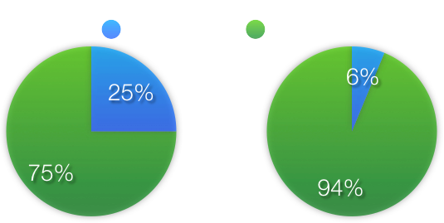
What to do with SIMD?
4 way SIMD (SSE)
16 way SIMD (Phi)
Neglecting SIMD is becoming more expensive
AVX: 8 way SIMD, Xeon Phi: 16 way SIMD, Nvidia: 32 way SIMD, AMD: 64 way SIMD
This problem composes with thread level parallelism
We need a programming model which addresses both problems

Slide 9
The CUDA Programming Model
CUDA is a programming model designed for:
Heterogeneous architectures
Wide SIMD parallelism
Scalability
CUDA provides:
A thread abstraction to deal with SIMD
Synchronization & data sharing between small thread groups
CUDA programs are written in C++ with minimal extensions
OpenCL is inspired by CUDA, but HW & SW vendor neutral

Slide 10
Hello World: Vector Addition
//Compute vector sum C=A+B
//Each thread performs one pairwise addition
__global__ void vecAdd(float* a, float* b, float* c) {
int i = blockIdx.x * blockDim.x + threadIdx.x;
c[i] = a[i] + b[i];
}
int main() {
//Run N/256 blocks of 256 threads each
vecAdd<<<N/256, 256>>>(d_a, d_b, d_c);
}

Slide 11
Hierarchy of Concurrent Threads
Thread t
Parallel kernels composed of many threads
all threads execute the same sequential program
Threads are grouped into thread blocks
threads in the same block can cooperate
Threads/blocks have unique IDs
Block b
t0 t1 … tN

Slide 12
What is a CUDA Thread?
Independent thread of execution
has its own program counter, variables (registers), processor state, etc.
no implication about how threads are scheduled
CUDA threads might be physical threads
as mapped onto NVIDIA GPUs
CUDA threads might be virtual threads
might pick 1 block = 1 physical thread on multicore CPU

Slide 13
What is a CUDA Thread Block?
Thread block = a (data) parallel task
all blocks in kernel have the same entry point
but may execute any code they want
Thread blocks of kernel must be independent tasks
program valid for any interleaving of block executions

Slide 14
CUDA Supports:
Thread parallelism
each thread is an independent thread of execution
Data parallelism
across threads in a block
across blocks in a kernel
Task parallelism
different blocks are independent
independent kernels executing in separate streams

Slide 15
Synchronization
Threads within a block may synchronize with barriers
… Step 1 … __syncthreads(); … Step 2 …
Blocks coordinate via atomic memory operations
e.g., increment shared queue pointer with atomicInc()
Implicit barrier between dependent kernels
vec_minus<<<nblocks, blksize>>>(a, b, c);
vec_dot<<<nblocks, blksize>>>(c, c);

Slide 16
Blocks must be independent
Any possible interleaving of blocks should be valid
presumed to run to completion without pre-emption
can run in any order
can run concurrently OR sequentially
Blocks may coordinate but not synchronize
shared queue pointer: OK
shared lock: BAD … can easily deadlock
Independence requirement gives scalability

Slide 17
Scalability
Manycore chips exist in a diverse set of configurations
Number of SMs
CUDA allows one binary to target all these chips
Thread blocks bring scalability!

Slide 18
Memory model
Block
Thread
Per-thread Local Memory
Per-block Shared Memory

Slide 19
Memory model
Kernel 0
Per Device Global Memory
…
Sequential
Kernels
Kernel 1
…

Slide 20
Memory model
Host Memory
Device 0 Memory
cudaMemcpy()
Device 1 Memory

Slide 21
Hello World: Vector Addition
//Compute vector sum C=A+B
//Each thread performs one pairwise addition
__global__ void vecAdd(float* a, float* b, float* c) {
int i = blockIdx.x * blockDim.x + threadIdx.x;
c[i] = a[i] + b[i];
}
int main() {
//Run N/256 blocks of 256 threads each
vecAdd<<<N/256, 256>>>(d_a, d_b, d_c);
}

Slide 22
Hello World: Managing Data
int main() {
int N = 256 * 1024;
float* h_a = malloc(sizeof(float) * N);
//Similarly for h_b, h_c. Initialize h_a, h_b
float *d_a, *d_b, *d_c;
cudaMalloc(&d_a, sizeof(float) * N);
//Similarly for d_b, d_c
cudaMemcpy(d_a, h_a, sizeof(float) * N, cudaMemcpyHostToDevice);
//Similarly for d_b
//Run N/256 blocks of 256 threads each
vecAdd<<<N/256, 256>>>(d_a, d_b, d_c);
cudaMemcpy(h_c, d_c, sizeof(float) * N, cudaMemcpyDeviceToHost);
}

Slide 23
CUDA: Minimal extensions to C/C++
Declaration specifiers to indicate where things live
__global__ void KernelFunc(...); // kernel callable from host
__device__ void DeviceFunc(...); // function callable on device
__device__ int GlobalVar; // variable in device memory
__shared__ int SharedVar; // in per-block shared memory
Extend function invocation syntax for parallel kernel launch
KernelFunc<<<500, 128>>>(...); // 500 blocks, 128 threads each
Special variables for thread identification in kernels
dim3 threadIdx; dim3 blockIdx; dim3 blockDim;
Intrinsics that expose specific operations in kernel code
__syncthreads(); // barrier synchronization
Notes:
Simple model, extending C only where necessary

Slide 24
Using per-block shared memory
Block
Variables shared across block
__shared__ int *begin, *end;
Scratchpad memory
__shared__ int scratch[BLOCKSIZE];
scratch[threadIdx.x] = begin[threadIdx.x]; // … compute on scratch values … begin[threadIdx.x] = scratch[threadIdx.x];
Communicating values between threads
scratch[threadIdx.x] = begin[threadIdx.x];
__syncthreads(); int left = scratch[threadIdx.x - 1];
Per-block shared memory is faster than L1 cache, slower than register file
It is relatively small: register file is 2-4x larger
Shared

Slide 25
CUDA: Features available on GPU
Double and single precision (IEEE compliant)
Standard mathematical functions
sinf, powf, atanf, ceil, min, sqrtf, etc.
Atomic memory operations
atomicAdd, atomicMin, atomicAnd, atomicCAS, etc.
These work on both global and shared memory

Slide 26
CUDA: Runtime support
Explicit memory allocation returns pointers to GPU memory
cudaMalloc(), cudaFree()
Explicit memory copy for host ↔ device, device ↔ device
cudaMemcpy(), cudaMemcpy2D(), ...
Texture management
cudaBindTexture(), cudaBindTextureToArray(), ...
OpenGL & DirectX interoperability
cudaGLMapBufferObject(), cudaD3D9MapVertexBuffer(), …

Slide 27
OpenCL
OpenCL is supported by AMD {CPUs, GPUs} and Nvidia
Intel, Imagination Technologies (purveyor of GPUs for iPhone/etc.) are also on board
OpenCL’s data parallel execution model mirrors CUDA, but with different terminology
OpenCL has rich task parallelism model
Runtime walks a dependence DAG of kernels/memory transfers

Slide 28
CUDA and OpenCL correspondence
Thread
Thread-block
Global memory
Constant memory
Shared memory
Local memory
__global__ function
__device__ function
__constant__ variable
__device__ variable
__shared__ variable
Work-item
Work-group
Global memory
Constant memory
Local memory
Private memory
__kernel function
no qualification needed
__constant variable
__global variable
__local variable

Slide 29
OpenCL and SIMD
SIMD issues are handled separately by each runtime
AMD GPU Runtime
Vectorizes over 64-way SIMD
Prefers scalar code per work-item (on newer AMD GPUs)
AMD CPU Runtime
No vectorization
Use float4 vectors in your code (float8 when AVX appears?)
Intel CPU Runtime
Vectorization optional, using float4/float8 vectors still good idea
Nvidia GPU Runtime
Full vectorization, like CUDA
Prefers scalar code per work-item

Slide 30
Imperatives for Efficient CUDA Code
Expose abundant fine-grained parallelism
need 1000’s of threads for full utilization
Maximize on-chip work
on-chip memory orders of magnitude faster
Minimize execution divergence
SIMT execution of threads in 32-thread warps
Minimize memory divergence
warp loads and consumes complete 128-byte cache line

Slide 31
Mapping CUDA to Nvidia GPUs
CUDA is designed to be functionally forgiving
First priority: make things work. Second: get performance.
However, to get good performance, one must understand how CUDA is mapped to Nvidia GPUs
Threads: each thread is a SIMD vector lane
Warps: A SIMD instruction acts on a “warp”
Warp width is 32 elements: LOGICAL SIMD width
Thread blocks: Each thread block is scheduled onto an SM
Peak efficiency requires multiple thread blocks per SM

Slide 32
Mapping CUDA to a GPU, continued
The GPU is very deeply pipelined to maximize throughput
This means that performance depends on the number of thread blocks which can be allocated on a processor
Therefore, resource usage costs performance:
More registers => Fewer thread blocks
More shared memory usage => Fewer thread blocks
It is often worth trying to reduce register count in order to get more thread blocks to fit on the chip
For Kepler, target 32 registers or less per thread for full occupancy

Slide 33
Occupancy (Constants for Kepler)
The Runtime tries to fit as many thread blocks simultaneously as possible on to an SM
The number of simultaneous thread blocks (B) is ≤ 8
The number of warps per thread block (T) ≤ 32
Each SM has scheduler space for 64 warps (W)
B * T ≤ W=64
The number of threads per warp (V) is 32
B * T * V * Registers per thread ≤ 65536
B * Shared memory (bytes) per block ≤ 49152/16384
Depending on Shared memory/L1 cache configuration
Occupancy is reported as B * T / W

Slide 34
Profiling
nvvp (nvidia visual profiler) useful for interactive profiling
export CUDA_PROFILE=1 in shell for simple profiler
Then examine cuda_profile_*.log for kernel times & occupancies

Slide 35
SIMD & Control Flow
Nvidia GPU hardware handles control flow divergence and reconvergence
Write scalar SIMD code, the hardware schedules the SIMD execution
One caveat: __syncthreads() can’t appear in a divergent path
This may cause programs to hang
Good performing code will try to keep the execution convergent within a warp
Warp divergence only costs because of a finite instruction cache

Slide 36
Memory, Memory, Memory
A many core processor ≡ A device for turning a compute bound problem into a memory bound problem Kathy Yelick, Berkeley
Lots of processors, only one socket
Memory concerns dominate performance tuning

Slide 37
Memory is SIMD too
Virtually all processors have SIMD memory subsystems
0
1
2
3
4
5
6
7
cache line width
This has two effects:
Sparse access wastes bandwidth
2 words used, 8 words loaded:
¼ effective bandwidth
0
1
2
3
4
5
6
7
Unaligned access wastes bandwidth
4 words used, 8 words loaded:
½ effective bandwidth
0
1
2
3
4
5
6
7

Slide 38
Coalescing
GPUs and CPUs both perform memory transactions at a larger granularity than the program requests (“cache line”)
GPUs have a “coalescer”, which examines memory requests dynamically from different SIMD lanes and coalesces them
To use bandwidth effectively, when threads load, they should:
Present a set of unit strided loads (dense accesses)
Keep sets of loads aligned to vector boundaries

Slide 39
Data Structure Padding
L
(row major)
Multidimensional arrays are usually stored as monolithic vectors in memory
Care should be taken to assure aligned memory accesses for the necessary access pattern
J

Slide 40
SoA, AoS
Different data access patterns may also require transposing data structures
T
Array of Structs
Structure of Arrays
The cost of a transpose on the data structure is often much less than the cost of uncoalesced memory accesses
Use shared memory to handle block transposes

Slide 41


Efficiency vs Productivity
Productivity is often in tension with efficiency
This is often called the “abstraction tax”
Efficiency Language
Productivity Language
C
Low level
High level
Less Productive
Fast
Slow
More Productive

Slide 42
Efficiency and Productivity
Parallel programming also gives us a “concrete tax”
How many of you have tried to write … which is faster than a vendor supplied library?
Divergent Parallel Architectures means performance portability is increasingly elusive
Low-level programming models tie you to a particular piece of hardware
And if you’re like me, often make your code slow
My SGEMM isn’t as good as NVIDIA’s
FFT
Sort
Reduce
SGEMM
Scan

Slide 43
The Concrete Tax: A Case Study
Wide Parallel Reduction (good for GPU)
Narrow Parallel
Reduction (good for CPU)
OpenCL experiment on CPU and GPU
Two optimized reductions, one for CPU, one for GPU
Running GPU code on CPU:
40X performance loss compared to CPU optimized code
Running CPU on GPU:
~100X performance loss compared to GPU optimized code
Concrete code led to overspecialization

Slide 44
Abstraction, cont.
Reduction is one of the simplest parallel computations
Performance differentials are even starker as complexity increases
There’s a need for abstractions at many levels
Primitive computations (BLAS, Data-parallel primitives)
Domain-specific languages
These abstractions make parallel programming more efficient and more productive
Use libraries whenever possible!
CUBLAS, CUFFT, Thrust

Slide 45

A C++ template library for CUDA
Mimics the C++ STL
Containers
On host and device
Algorithms
Sorting, reduction, scan, etc.
Notes:
C++ STL is a very well thought-out collection of generic algorithms
Interface is already familiar to programmers
Thrust uses nvcc to instantiate templated CUDA kernels from generic templated specifications

Slide 46
Diving In
#include <thrust/host_vector.h>
#include <thrust/device_vector.h>
#include <thrust/sort.h>
#include <cstdlib>
int main(void)
{
// generate 32M random numbers on the host
thrust::host_vector<int> h_vec(32 << 20);
thrust::generate(h_vec.begin(), h_vec.end(), rand);
// transfer data to the device
thrust::device_vector<int> d_vec = h_vec;
// sort data on the device (846M keys per sec on GeForce GTX 480)
thrust::sort(d_vec.begin(), d_vec.end());
// transfer data back to host
thrust::copy(d_vec.begin(), d_vec.end(), h_vec.begin());
return 0;
}
Notes:
this is a complete Thrust program
Thrust is a header library – all the functionality is accessed by #including the appropriate Thrust header file
This program is compiled with nvcc as per usual, no special tools are required

Slide 47
Objectives
Programmer productivity
Build complex applications quickly
Encourage generic programming
Leverage parallel primitives
High performance
Efficient mapping to hardware

Slide 48
Containers
Concise and readable code
Avoids common memory management errors
// allocate host vector with two elements
thrust::host_vector<int> h_vec(2);
// copy host vector to device
thrust::device_vector<int> d_vec = h_vec;
// write device values from the host
d_vec[0] = 13;
d_vec[1] = 27;
// read device values from the host
std::cout << "sum: " << d_vec[0] + d_vec[1] << std::endl;
Notes:
Vectors automatically release memory when they go out of scope
Abstracts CUDA runtime API (cudaMalloc, cudaMemcpy)

Slide 49
Iterators
Pair of iterators defines a range
// allocate device memory
device_vector<int> d_vec(10);
// declare iterator variables
device_vector<int>::iterator begin = d_vec.begin();
device_vector<int>::iterator end = d_vec.end();
device_vector<int>::iterator middle = begin + 5;
// sum first and second halves
int sum_half1 = reduce(begin, middle);
int sum_half2 = reduce(middle, end);
// empty range
int empty = reduce(begin, begin);

Slide 50
Iterators
Iterators act like pointers
// declare iterator variables
device_vector<int>::iterator begin = d_vec.begin();
device_vector<int>::iterator end = d_vec.end();
// pointer arithmetic
begin++;
// dereference device iterators from the host
int a = *begin;
int b = begin[3];
// compute size of range [begin,end)
int size = end - begin;

Slide 51
Iterators
Encode memory location
Automatic algorithm selection
// initialize random values on host
host_vector<int> h_vec(100);
generate(h_vec.begin(), h_vec.end(), rand);
// copy values to device
device_vector<int> d_vec = h_vec;
// compute sum on host
int h_sum = reduce(h_vec.begin(), h_vec.end());
// compute sum on device
int d_sum = reduce(d_vec.begin(), d_vec.end());

Slide 52
Algorithms
Elementwise operations
for_each, transform, gather, scatter …
Reductions
reduce, inner_product, reduce_by_key …
Prefix-Sums
inclusive_scan, inclusive_scan_by_key …
Sorting
sort, stable_sort, sort_by_key …

Slide 53
Algorithms
Standard operators
// allocate memory
device_vector<int> A(10);
device_vector<int> B(10);
device_vector<int> C(10);
// transform A + B -> C
transform(A.begin(), A.end(), B.begin(), C.begin(), plus<int>());
// transform A - B -> C
transform(A.begin(), A.end(), B.begin(), C.begin(), minus<int>());
// multiply reduction
int product = reduce(A.begin(), A.end(), 1, multiplies<int>());

Slide 54
Algorithms
Standard data types
// allocate device memory
device_vector<int> i_vec = ...
device_vector<float> f_vec = ...
// sum of integers
int i_sum = reduce(i_vec.begin(), i_vec.end());
// sum of floats
float f_sum = reduce(f_vec.begin(), f_vec.end());

Slide 55
Custom Types & Operators
struct negate_float2
{
__host__ __device__
float2 operator()(float2 a)
{
return make_float2(-a.x, -a.y);
}
};
// declare storage
device_vector<float2> input = ...
device_vector<float2> output = ...
// create function object or ‘functor’
negate_float2 func;
// negate vectors
transform(input.begin(), input.end(), output.begin(), func);
Notes:
We can implement “micro-kernels” as c++ functors

Slide 56
Custom Types & Operators
// compare x component of two float2 structures
struct compare_float2
{
__host__ __device__
bool operator()(float2 a, float2 b)
{
return a.x < b.x;
}
};
// declare storage
device_vector<float2> vec = ...
// create comparison functor
compare_float2 comp;
// sort elements by x component
sort(vec.begin(), vec.end(), comp);
Notes:
A predicate for sorting implemented as a functor

Slide 57
Interoperability
Convert iterators to raw pointers
// allocate device vector
thrust::device_vector<int> d_vec(4);
// obtain raw pointer to device vector’s memory
int * ptr = thrust::raw_pointer_cast(&d_vec[0]);
// use ptr in a CUDA C kernel
my_kernel<<< N / 256, 256 >>>(N, ptr);
// Note: ptr cannot be dereferenced on the host!

Slide 58
Recap
Containers manage memory
Help avoid common errors
Iterators define ranges
Know where data lives
Algorithms act on ranges
Support general types and operators

Slide 59
Explicit versus implicit parallelism
CUDA is explicit
Programmer’s responsibility to schedule resources
Decompose algorithm into kernels
Decompose kernels into blocks
Decompose blocks into threads
…
Kernel 1
…
Kernel 2
…

Slide 60
Explicit versus implicit parallelism
SAXPY in CUDA
__global__
void SAXPY(int n, float a, float * x, float * y)
{
int i = blockDim.x * blockIdx.x + threadIdx.x;
if (i < n)
y[i] = a * x[i] + y[i];
}
SAXPY <<< n/256, 256 >>>(n, a, x, y);

Slide 61
Explicit versus implicit parallelism
SAXPY in CUDA
__global__
void SAXPY(int n, float a, float * x, float * y)
{
int i = blockDim.x * blockIdx.x + threadIdx.x;
if (i < n)
y[i] = a * x[i] + y[i];
}
SAXPY <<< n/256, 256 >>>(n, a, x, y);
Decomposition

Slide 62
Explicit versus implicit parallelism
SAXPY in Thrust
// C++ functor replaces __global__ function
struct saxpy {
float a;
saxpy(float _a) : a(_a) {}
__host__ __device__
float operator()(float x, float y) {
return a * x + y;
}
};
transform(x.begin(), x.end(), y.begin(), y.begin(), saxpy(a));

Slide 63
Implicitly Parallel
Algorithms expose lots of fine-grained parallelism
Generally expose O(N) independent threads of execution
Minimal constraints on implementation details
Programmer identifies opportunities for parallelism
Thrust determines explicit decomposition onto hardware
Finding parallelism in sequential code is hard
Mapping parallel computations onto hardware is easier
Notes:
General strategy
Programmer identifies and exposes lots of parallelism via API
E.g. semantics of thrust::reduce() lets us reorder the reduction however we see fit
Runtime automatically

Slide 64
Productivity Implications
Consider a serial reduction
// sum reduction
int sum = 0;
for(i = 0; i < n; ++i)
sum += v[i];

Slide 65
Productivity Implications
Consider a serial reduction
// product reduction
int product = 1;
for(i = 0; i < n; ++i)
product *= v[i];

Slide 66
Productivity Implications
Consider a serial reduction
// max reduction
int max = 0;
for(i = 0; i < n; ++i)
max = std::max(max,v[i]);
Notes:
This kind of code replication is a natural thing to do
C programmers probably wouldn’t even think of this operation as a reduction, just iteration

Slide 67
Productivity Implications
Compare to low-level CUDA
int sum = 0;
for(i = 0; i < n; ++i)
sum += v[i];
__global__
void block_sum(const float *input,
float *per_block_results,
const size_t n)
{
extern __shared__ float sdata[];
unsigned int i = blockIdx.x * blockDim.x + threadIdx.x;
// load input into __shared__ memory
float x = 0;
if(i < n)
{
x = input[i];
...
Notes:
Ad hoc replication isn’t scalable in parallel codes as it is in serial codes

Slide 68
Leveraging Parallel Primitives
Use sort liberally
data type | std::sort | tbb::parallel_sort | thrust::sort
char | 25.1 | 68.3 | 3532.2
short | 15.1 | 46.8 | 1741.6
int | 10.6 | 35.1 | 804.8
long | 10.3 | 34.5 | 291.4
float | 8.7 | 28.4 | 819.8
double | 8.5 | 28.2 | 358.9
Intel Core i7 950
NVIDIA GeForce 480
Notes:
Lession: use
Sorting 32M keys on each platform - performance measured in millions of keys per second
CPU – Intel Core i7 950 @ 3.07 GHz
GPU – NVIDIA GeForce GTX 480
Lesson – use sorting instead of ad hoc binning b/c thrust::sort() is highly optimized

Slide 69
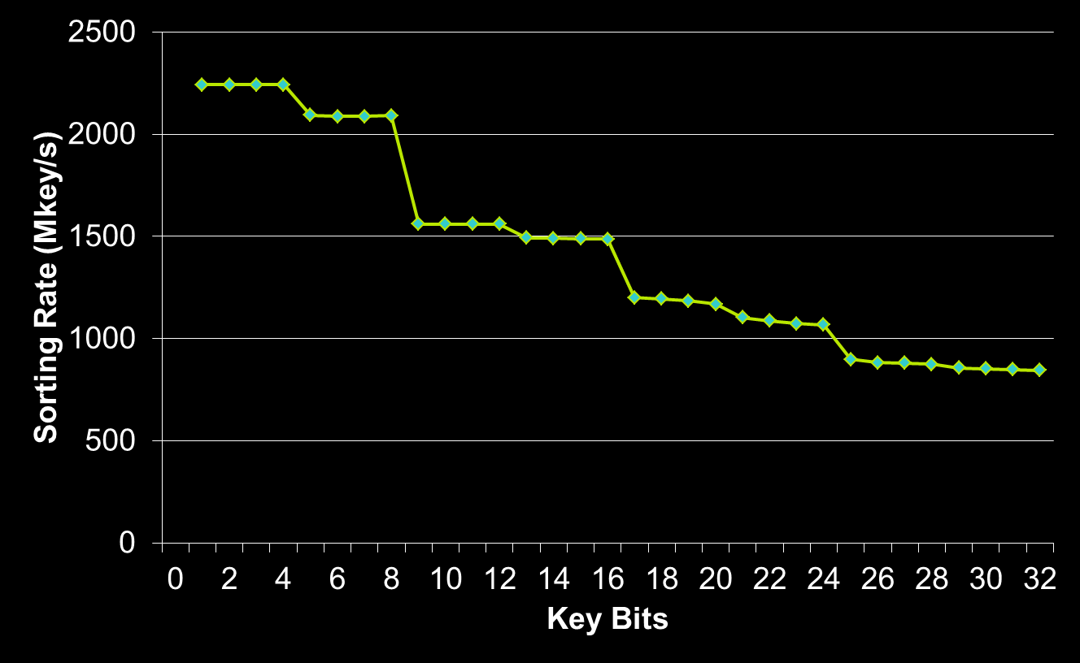
Input-Sensitive Optimizations
Notes:
Sorting 32M unsigned integers (uniformly distributed) with different numbers of occupied key bits
For example, Key Bits = 20 means all keys are in the range [0, 2^20)

Slide 70
Leveraging Parallel Primitives
Combine sort with reduce_by_key
Keyed reduction
Bring like items together, collapse
Poor man’s MapReduce
Can often be faster than custom solutions
I wrote an image histogram routine in CUDA
Bit-level optimizations and shared memory atomics
Was 2x slower than thrust::sort + thrust::reduce_by_key
Notes:
In the previous example we saw how to combine several Thrust algorithms (sort, unique, lower_bound) to implement a complex operation
This is a strategy that can be applied in general – using high level primitives

Slide 71
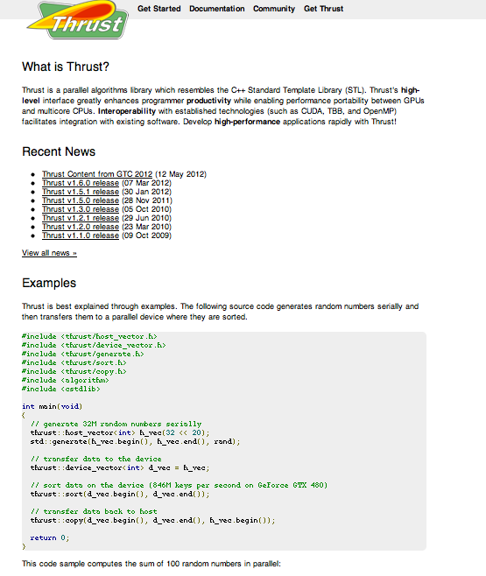
Thrust on github
Quick Start Guide
Examples
Documentation
Mailing list (thrust-users)

Slide 72
Summary
Throughput optimized processors complement latency optimized processors
Programming models like CUDA and OpenCL enable heterogeneous parallel programming
They abstract SIMD, making it easy to use wide SIMD vectors
CUDA and OpenCL encourages SIMD friendly, highly scalable algorithm design and implementation
Thrust is a productive C++ library for CUDA development

Slide 73
Questions?
Bryan Catanzaro
bcatanzaro@nvidia.com
http://research.nvidia.com

